Slide 1
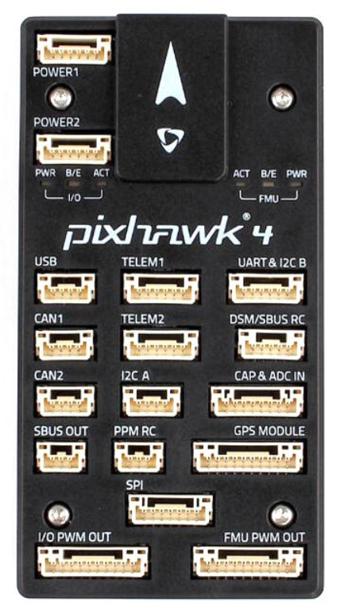
3s LiPo
Battery
Voltage
Regulator 1 & 2
5 V
Water
Servo
Telemetry
Radio
Habitat
Servo
CDA
Servo
Ch8 Ch7 Ch6 Ch5
PWM
Out
PPM
Encoder
Receiver
Ch1
Ch2
Ch3
Ch4
+
-
Ch1
Ch2
Ch3
Ch4
+
-
Ch1 Ch2 Ch3 Ch4
Aileron
Elevator
GPS
Throttle
Rudder

Slide 2
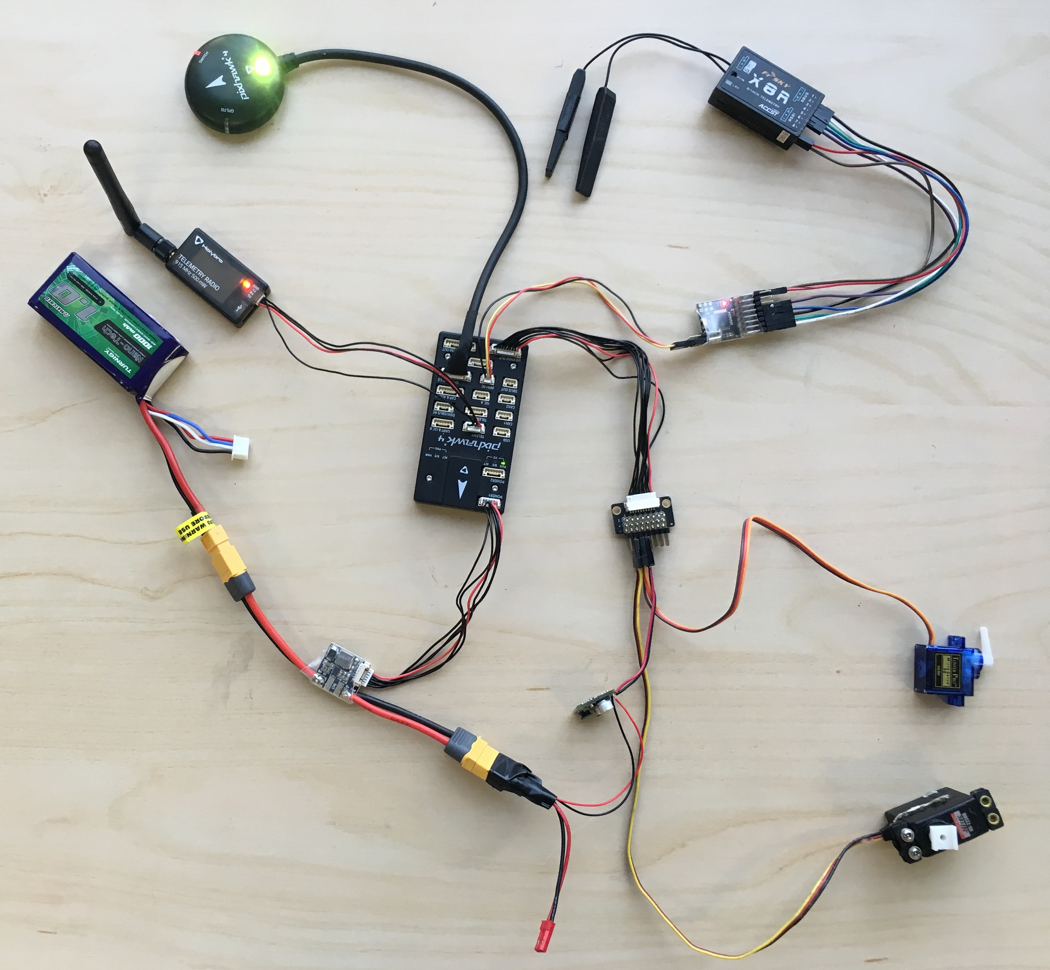

Slide 3
3s LiPo
Battery
Voltage
Regulator 1 & 2
FPV
Transmitter
FPV
Camera
11.1 V
5 V
Water
Servo
Telemetry
Radio
Habitat
Servo
CDA
Servo
Ch8 Ch7 Ch6 Ch5
PWM
Out
PPM
Encoder
Receiver
Ch1
Ch2
Ch3
Ch4
+
-
Ch1
Ch2
Ch3
Ch4
+
-
Ch1 Ch2 Ch3 Ch4
Aileron
Elevator
GPS
Throttle
Rudder

Slide 4
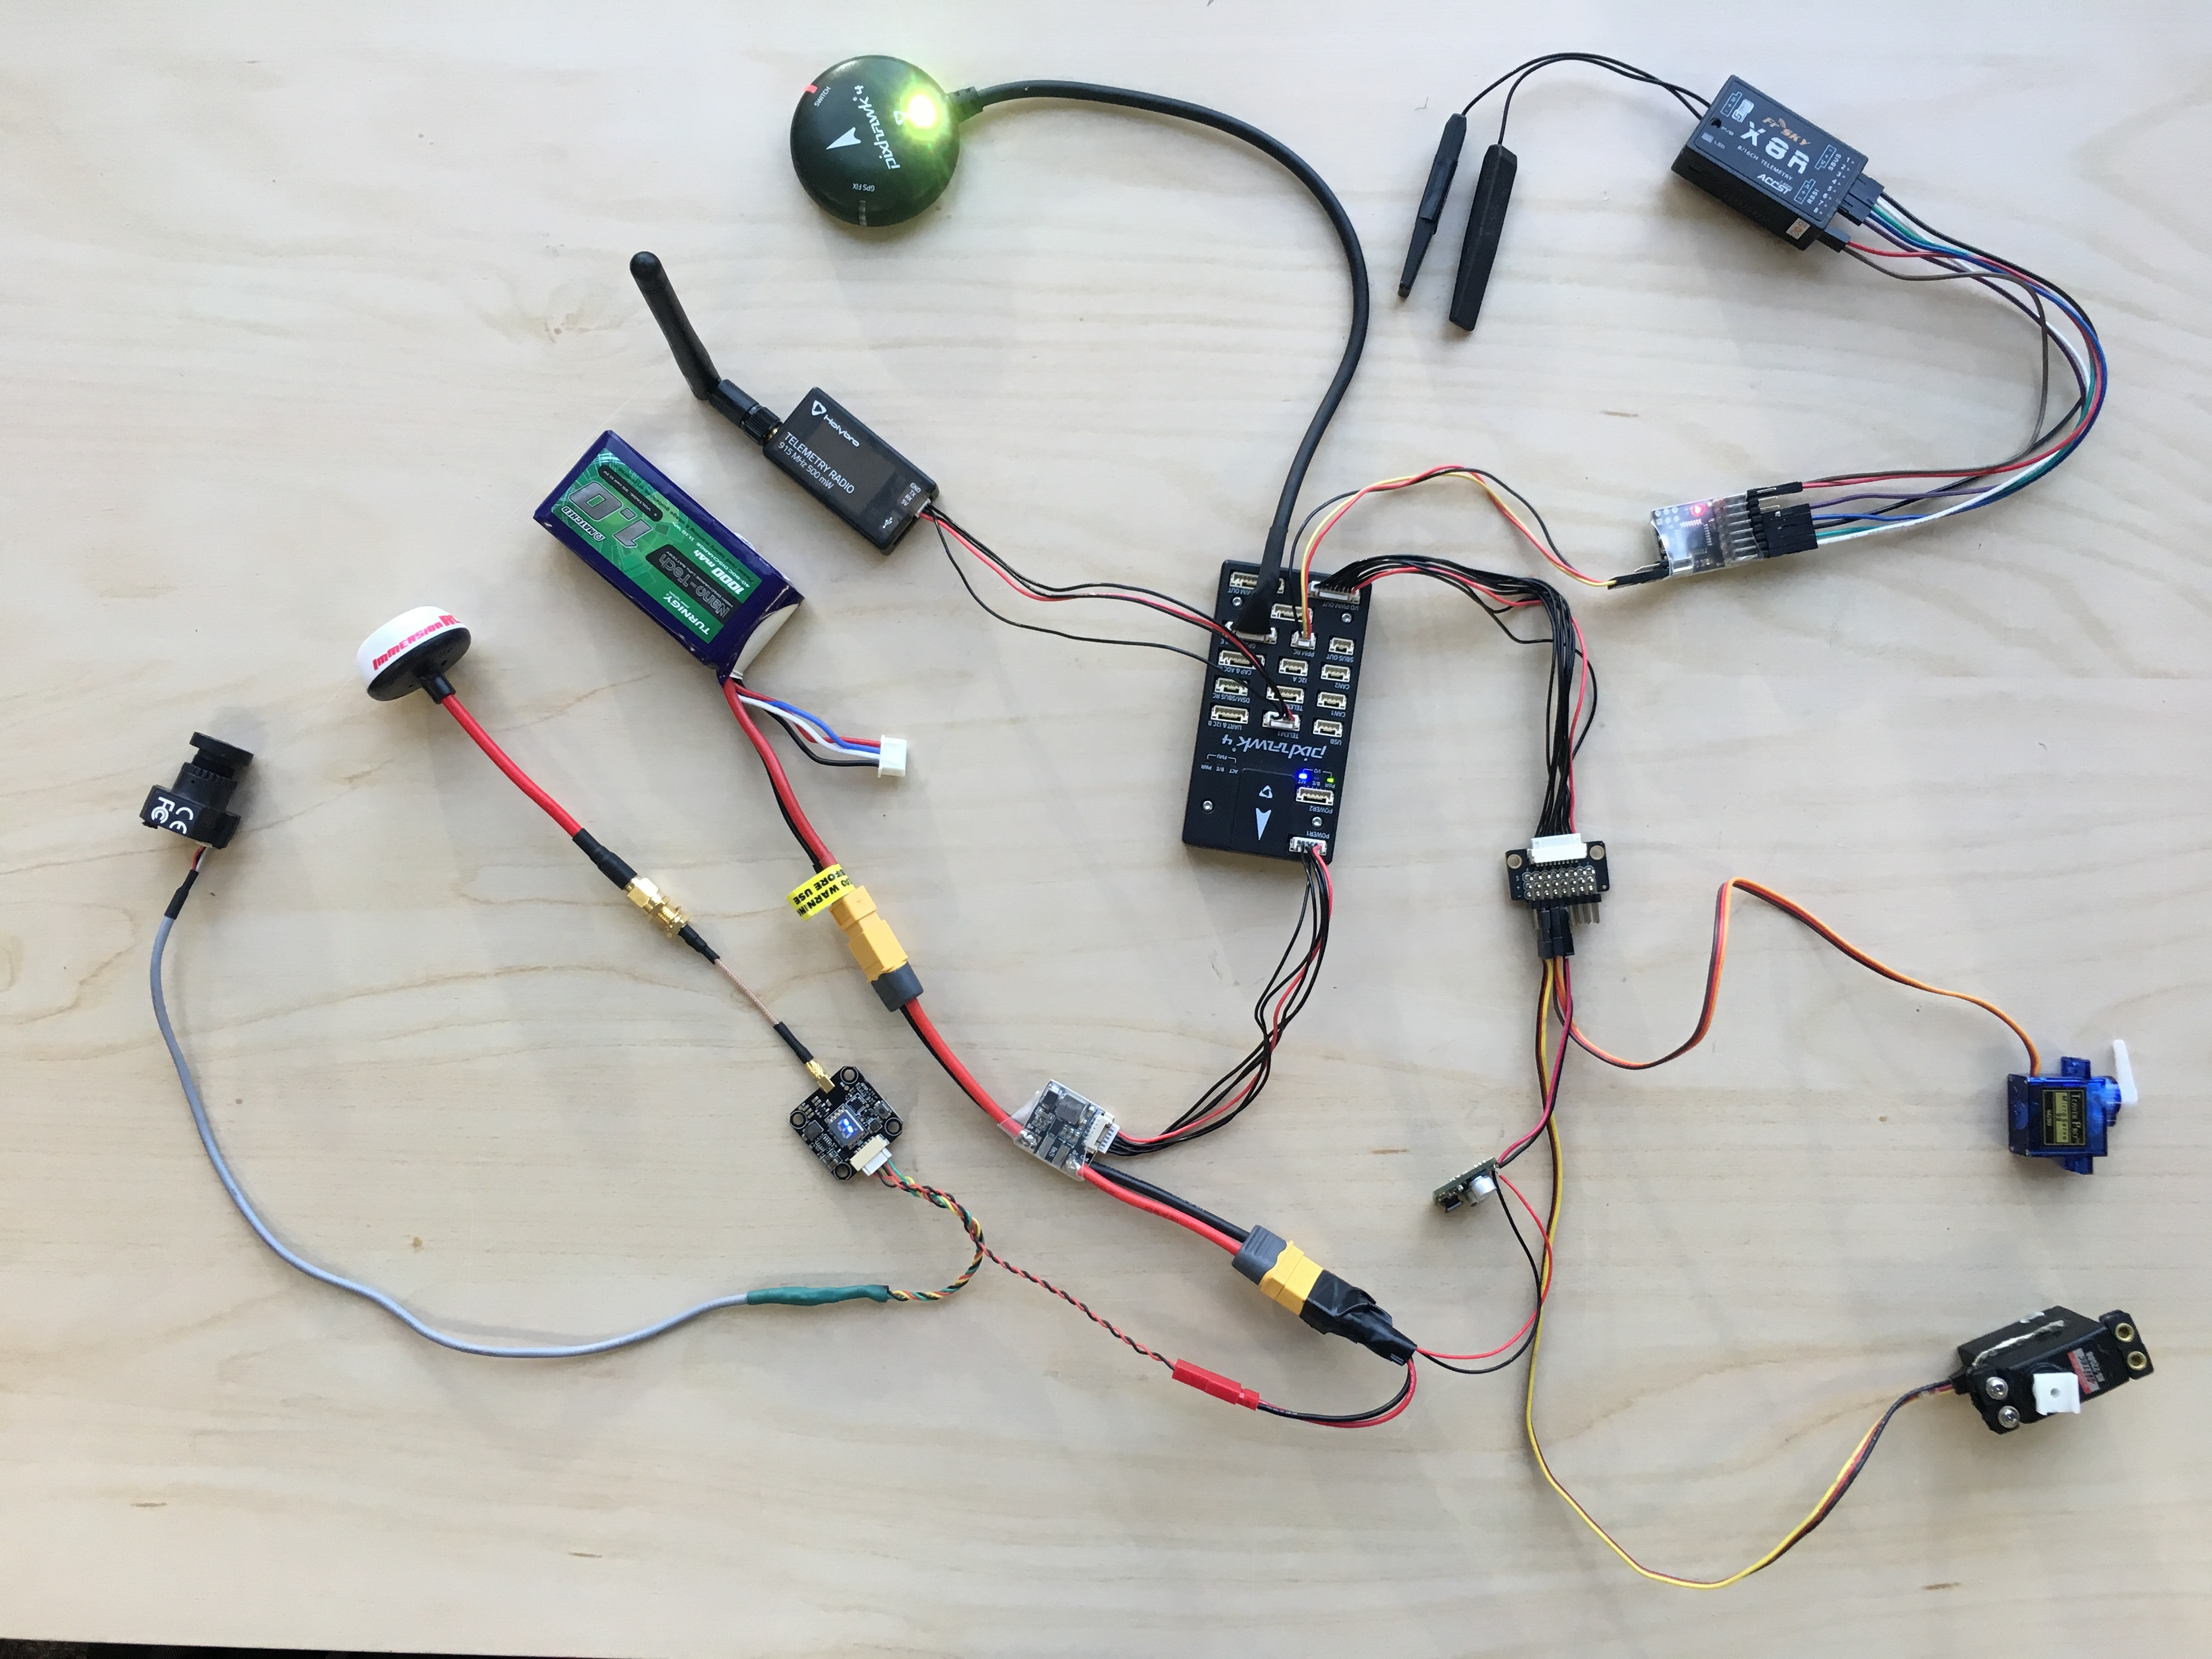

Slide 5
3s LiPo
Battery
Voltage
Regulator 1 & 2
FPV
Transmitter
FPV
Camera
11.1 V
5 V
Water
Servo
Telemetry
Radio
Habitat
Servo
CDA
Servo
Ch8 Ch7 Ch6 Ch5
PWM
Out
Ch1 Ch2 Ch3 Ch4
GPS

Slide 6
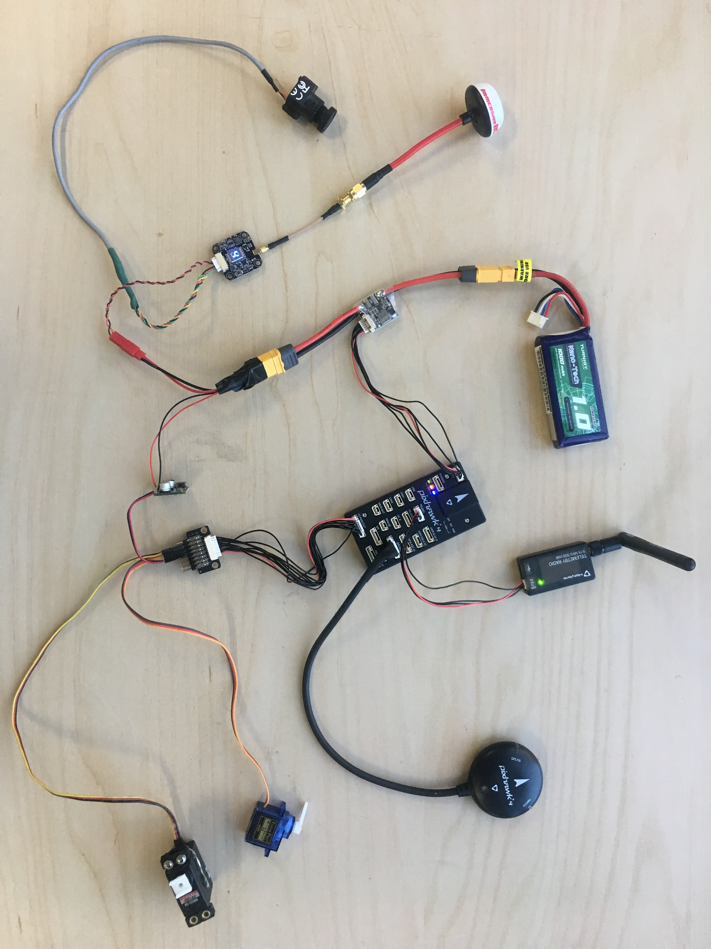

Slide 7
3s LiPo
Battery
Voltage
Regulator 1 & 2
5 V
Water
Servo
Telemetry
Radio
Habitat
Servo
CDA
Servo
Ch8 Ch7 Ch6 Ch5
PWM
Out
Ch1 Ch2 Ch3 Ch4
GPS

Slide 8
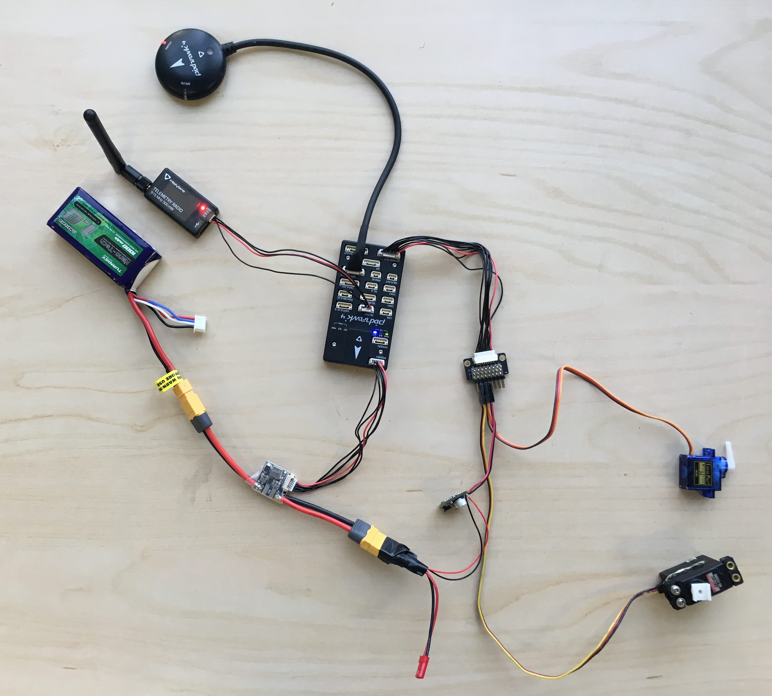

Slide 9
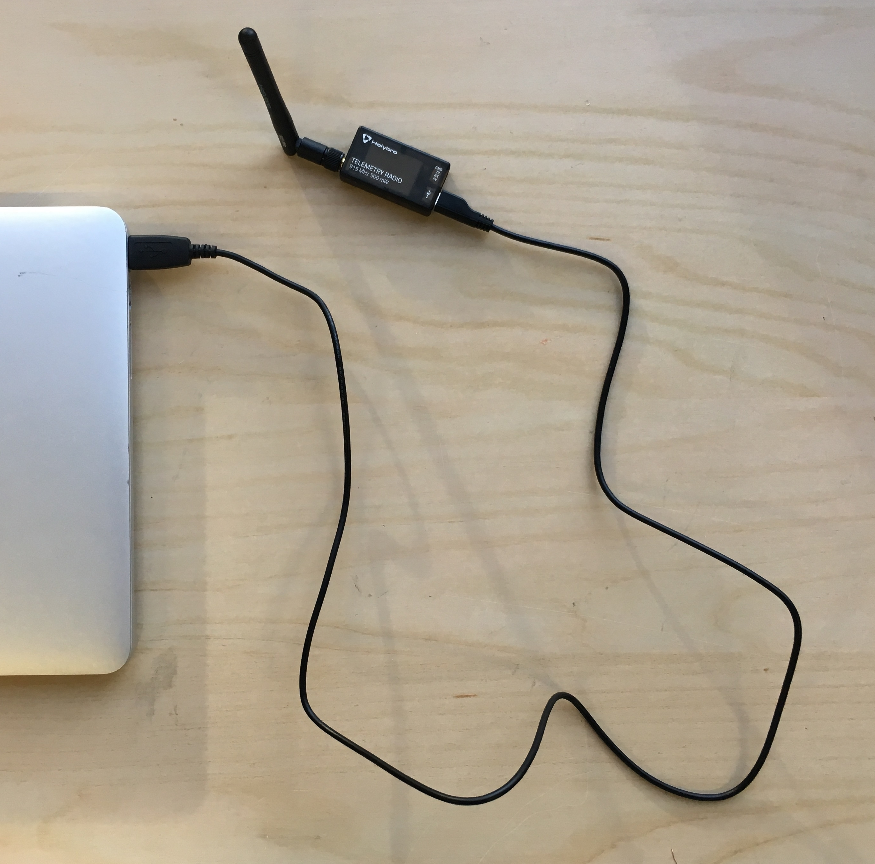
Laptop
Telemetry
Radio

Slide 10
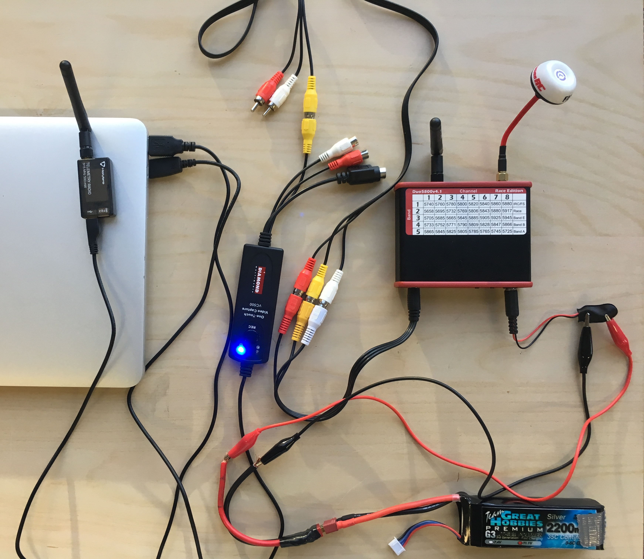
Laptop
11.1 V
3s LiPo
Battery
FPV
Receiver
VC 500 USB Image Capture
Telemetry
Radio

Slide 11
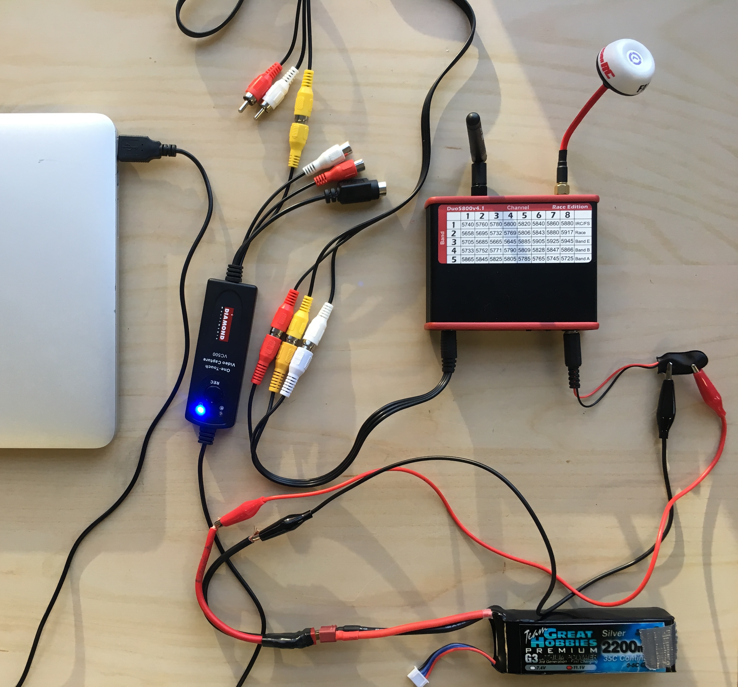
Laptop
11.1 V
3s LiPo
Battery
FPV
Receiver
VC 500 USB Image Capture

Slide 12
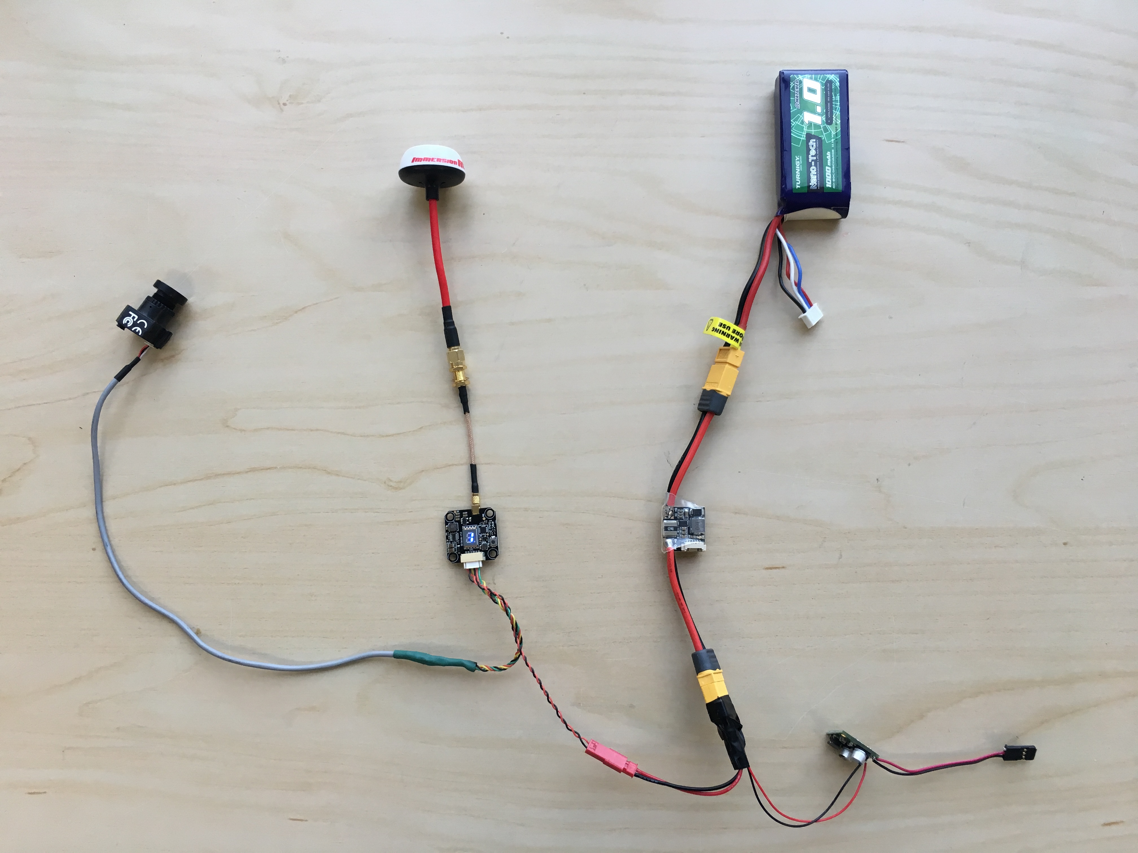
11.1 V
5 V
3s LiPo
Battery
FPV
Transmitter
FPV
Camera

